Slide 1

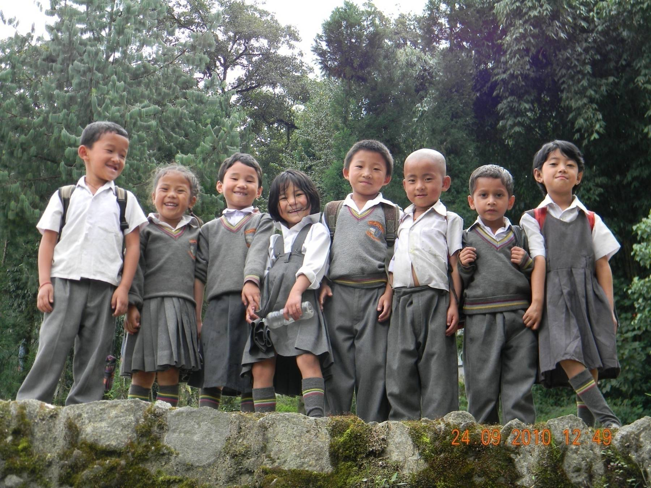
Indian Early Childhood Education
Impact Study (IECEI)
Pathways & learning in early years:
Findings from a longitudinal sample study
ASER Centre | B 4/54 Safdarjung Enclave, New Delhi 110029 | www.asercentre.org

Slide 2
Methodology trends in participation TRENDS IN LEARNING summary

Slide 3
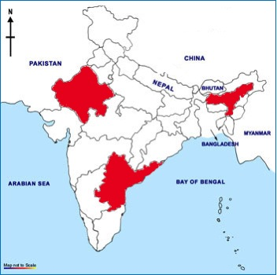
Sampling
Key features:
Large scale rapid assessment
District level estimates of participation and early learning
2 districts in each of 3 states (Telengana, Assam, Rajasthan)
50 villages per district with pop > 2,000 hab. were randomly selected from Census 2001 village list
Intended sample: 50 randomly selected children per village in the age group 3.5-4.5 at the time of the baseline visit
Actual sample: average of 39 children per village overall
33 children per village in Telengana
39 children per village in Assam
46 children per village in Rajasthan
All ECE centres in sampled villages – avg 3-5 per village

Slide 4
Summary of data presented (N=7191)
Tracking enrollment and attendance to estimate ‘participation’ and ‘dosage’ - Visits 1, 2, 3, 4, 5, 6, 7
School Readiness Assessment - sampled children – Visits 1 & 4
Basic concepts and vocabulary
Basic cognitive skills
Basic language skills
Pre literacy
Early Learning assessment (Grade 1) - sampled children – Visit 7
Early language: Print concepts, writing, oral skills (sentence formation)
Early arithmetic: Single and double digit number recognition, simple word and numeric sums
Cognitive: Classification, pattern making, sequencing

Slide 5
Methodology trends in participation TRENDS IN LEARNING summary

Slide 6
The big picture
At Visit 1, children are 3.5-4.5 years old…
Most children in these states are already attending some institution – Anganwadi, other ECE facility, primary school. Participation is often irregular and informal.
High provisioning of ECE Centres did not necessarily mean participation (RJ)
In the subsequent years…
Children take many ‘pathways’ through ECE and/or primary school. These ‘pathways’ are very different in each state in our sample.
At Visit 4, children are 4.5-5.5 years old…
Children are entering school before the official age
At Visit 7, children are 5.5-6.5 years old…
Over two-thirds children are in primary school, although large proportions are below the official age of entry to school.

Slide 7
Pathways: Telangana
Provision
State | Proportion of sampled villages with:
 | Angan-wadi | Other preschool facility | Govt primary school | Pvt primary school
TG | 100.0 | 34.4 | 88.5 | 26.2
AS | 100.0 | 25.7 | 88.5 | 24.8
RJ | 100.0 | 89.9 | 73.5 | 76.5
Year 1: Over half of all children were in AWCs. 1 in 5 went to a facility outside village
Year 2: 4 out 10 were in school and a similar number in private ECEs and centres
Year 3: 6 out of 10 children were in school and a third still in ECE
Year 3
Participation
Year 2
Year 1

Slide 8
Pathways: Assam
State | Proportion of sampled villages with:
 | Angan-wadi | Other preschool facility | Govt primary school | Pvt primary school
TG | 100.0 | 34.4 | 88.5 | 26.2
AS | 100.0 | 25.7 | 88.5 | 24.8
RJ | 100.0 | 89.9 | 73.5 | 76.5
Year 1: Over 80% children were in AWCs. 1 out of 5 went to a facility outside village
Year 2: Two-thirds children were in AWCs. 1 in 10 children were in centres outside village
Year 3: Over 40% children were still in ECE while a third had moved to primary school
Provision
Year 3
Participation
Year 2
Year 1

Slide 9
Pathways: Rajasthan
Provision
State | Proportion of sampled villages with:
 | Angan-wadi | Other preschool facility | Govt primary school | Pvt primary school
TG | 100.0 | 34.4 | 88.5 | 26.2
AS | 100.0 | 25.7 | 88.5 | 24.8
RJ | 100.0 | 89.9 | 73.5 | 76.5
Year 1: Provision of ECE facilities is far higher in RJ than in the other states.
But in all visits, high proportions of children not participating.
Equally high are proportions in formal schools, right from Year 1 onwards
Year 3
Participation
Year 2
Year 1

Slide 10
Summary of participation at Visit 7
At Visit 7 (October – November 2013), over two-thirds of all children
were in school although there are state variations.
TG has highest proportion of children who transitioned into school in
Year 3, followed by Rajasthan while in Assam, over half of all children
remain in ECEs.
Transition into school is not uniform among children in different states

Slide 11
Estimating ‘dosage’: Type of Institution
State | N | No Dosage | Participating in: |  | Participating in all 7 visits: |  |  | TOTAL
 |  |  | 1-3 visits | 4-5 visits | In Primary school | In pre-primary | Combination of both
TG | 1,986 | 0.0 | 0.0 | 2.0 | 4.9 | 14.8 | 78.3 | 100
AS | 2,032 | 0.0 | 0.1 | 2.5 | 0.1 | 40.5 | 56.9 | 100
RJ | 3,173 | 0.6 | 6.0 | 16.0 | 10.6 | 14.3 | 52.5 | 100
Total | 7,191 | 0.3 | 2.7 | 8.3 | 6.1 | 21.8 | 60.9 | 100
In 2 of 3 states, over 95% children were enrollment somewhere on all 7 visits. In RJ higher proportions participate ‘irregularly’
In TG over three quarters of all children have mixed exposure, to both pre-primary and primary
With irregular participation or with movement between different types of centres, how can impact be allocated?

Slide 12
Methodology trends in participation TRENDS IN learning summary

Slide 13
Learning in 3 years: School Readiness & Grade 1
% Children tested thrice
State | N
RJ | 3,173
AS | 2,032
TG | 1,986
Mean % Scores in Tests
SRI Year 1
SRI Year 2
Grade 1 Year 3
All children improve across tests BUT …
Overall levels are comparatively low and there are variations in performance by state
While children in Assam and TG have similar scores on SRI, those in TG do better on Grade 1 assessment

Slide 14
Dosage and ‘Type’ also matter
Mean % Scores by Dosage Category
Test | Participating in: |  | Full Participation on 7 visits:
 | 1-3 visits | 4-5 visits | RJ | Assam | TG
Baseline | 14.6 | 19.9 | 22.2 | 33.5 | 32.8
Endline 1 | 22.0 | 34.4 | 40.0 | 46.7 | 45.7
Endline 2 | 20.4 | 36.6 | 47.9 | 48.4 | 58.9
Children who participate more (frequency of enrollment) do have better outcomes
But even within the full dosage category, ‘type’ of dosage and state matters
Mean % scores for Full ECE & Mixed Dosage Children
Test | RJ |  | AS |  | TG
 | ECE | Mixed | ECE | Mixed | ECE | Mixed
Baseline | 23.9 | 22.4 | 30.1 | 36.0 | 31.4 | 33.1
Endline 1 | 35.9 | 41.5 | 40.6 | 51.1 | 45.4 | 45.3
Endline 2 | 43.1 | 50.0 | 36.8 | 56.8 | 53.7 | 59.4

Slide 15
ECE and School Continuum: Early language and math skills
% Children who scored full on the following questions:
Language: Phonetics |  | BL | EL | EL 2
 | Full ECE | 3.4 | 7.1 | 17.8
 | Full Mixed | 6.0 | 12.2 | 32.5
Language: Oral sentence making |  | BL | EL | EL 2
 | Full ECE | 11.2 | 10.9 | 11.6
 | Full Mixed | 16.2 | 16.7 | 18.9
Math: Relative Number comparisons |  | BL | EL | EL 2
 | Full ECE | 7.3 | 25.1 | 68.9
 | Full Mixed | 11.4 | 34.9 | 76.4

Slide 16
Methodology trends in participation TRENDS IN LEARNING summary

Slide 17
Summary & Conclusions
Pre-primary matters but there is need for policy to define the number of years of ECE exposure required for a child
Young children are entering formal school environments earlier than the official age. What will be the challenges associated for such children with learning in an developmentally-inappropriate environment?
There is need to look at Age 3-6/7/8 as the ‘early learning years’ so that a continuum can be maintained
For India, children entering school are doing so with limited skills. Expectations thus need to be realistic, based on childrens’ levels rather than on vague curriculum frameworks and textbooks

Slide 18
Indian Early Childhood Education Impact Study (IECEI)
ASER Centre, B-4/54, Safdarjung Enclave, New Delhi, India
www.asercentre.org
purnima.ramanujan@asercentre.org

